Slide 1
An introduction to Machine Learning
Huichao Zhao

Slide 2

INTRODUCTION
Who am I ?
Current:
Sr. Software Engineer in FutureWei@IntelliProGroup
Previous:
Big Data Engineer in MetiStream (2015)
Software Engineer in QuantGroup (2014-2015)
Algorithms R&D Engineer in Tokyo Keiso CO., LTD. ( 2010 – 2014)
PhD in Control Science and Engineering Tsinghua University(2010-2015)
Ping ME
zhaohc10@gmail.com

Slide 3
INTRODUCTION
Target Audience
Software Engineers
Data Engineers / Scientist
ETL Developers

Slide 4
INTRODUCTION
Course Prerequisites
Familiarity with the probability theory.
Familiarity with linear algebra
Basic familiarity with Linux or Unix
Intermediate-level programming skills in either Scala or Python
No prior knowledge of Spark, Hadoop, Tensorflow or distributed programming concepts is required

Slide 5
INTRODUCTION
Success Criteria of this Overview
By end of day, participants will be comfortable with the following:
Traditional CS vs machine learning
Three basic processes in machine learning
Difference between supervised learning and unsupervised learning
How evaluate the trained model
What about neural network and deep learning (option)

Slide 6
INTRODUCTION
OUTLINE AND SCOPE
Introduction
Scope and Motivation
Machine Learning: What, Why and How?
Objectives of the Course
Terminology / Basic Concepts
First ML Toy Example
Support Vector Machine
Decision tree
Artificial Neural Network
Model Evaluation & Improvement
How can I become a Data Scientist
Appendix
What about Deep Learning (option)

Slide 7
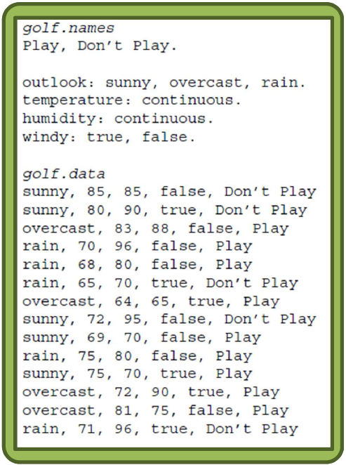
MACHINE LEARNING BACKGROUND
WHAT IS MACHINE LEARNING?
Machine Learning: What?
Introductory example:
When to play golf?
Collect data
– Consulting experts
(e.g., golf players)
– Watching players
– Collecting weather data, etc
From [Menzies, 2002]

Slide 8
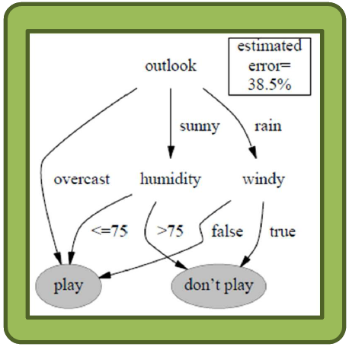
MACHINE LEARNING BACKGROUND
WHAT IS MACHINE LEARNING?
Machine Learning: What?
Introductory example:
When to play golf?
Create a model using one/
several classifiers
– E.g., decision trees
Evaluate model
– E.g., classification error
From [Menzies, 2002]

Slide 9
MACHINE LEARNING BACKGROUND
WHAT IS MACHINE LEARNING?
Machine Learning: What?
A branch of Artificial Intelligence (AI)
Wikipedia:
Machine learning explores the study and construction of algorithms that can learn from and make predictions on data. Such algorithms operate by building a model from example inputs in order to make data-driven predictions or decisions expressed as outputs rather than following strictly static program instructions.

Slide 10
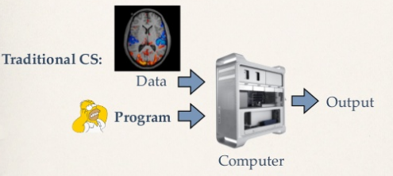
MACHINE LEARNING BACKGROUND
WHAT IS MACHINE LEARNING?
Kilian Weinberger,2014

Slide 11
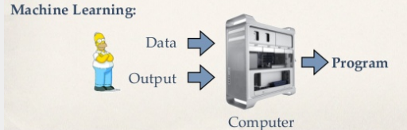
MACHINE LEARNING BACKGROUND
WHAT IS MACHINE LEARNING?
Kilian Weinberger,2014

Slide 12
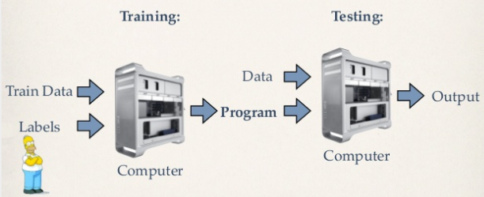
MACHINE LEARNING BACKGROUND
WHAT IS MACHINE LEARNING?
Kilian Weinberger,2014

Slide 13
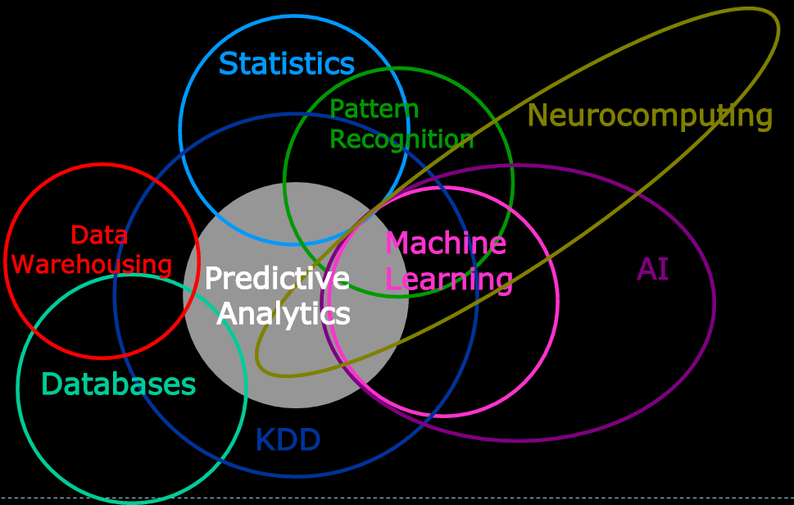
MACHINE LEARNING BACKGROUND
WHAT IS MACHINE LEARNING?
Machine Learning: What?
Multidisciplinary field
http://slideplayer.com/slide/4847315/

Slide 14
MACHINE LEARNING BACKGROUND
WHAT IS MACHINE LEARNING?
Machine Learning: What?
Machine Learning vs Statistical Inference vs Pattern Recognition vs Data Mining
Fuzzy concepts, large intersection…
Rui Pedro Paiva,2013

Slide 15
MACHINE LEARNING BACKGROUND
WHAT IS MACHINE LEARNING?
Machine Learning: What?
Machine Learning vs Statistical Inference vs Pattern Recognition vs Data Mining
Fuzzy concepts, large intersection…
Perspective 1
– Some argue they are just different words and notation for the same things
Rui Pedro Paiva,2013

Slide 16
MACHINE LEARNING BACKGROUND
WHAT IS MACHINE LEARNING?
Machine Learning: What?
Machine Learning vs Statistical Inference vs Pattern Recognition vs Data Mining
Fuzzy concepts, large intersection…
Perspective 1
– Some argue they are just different words and notation for the same things
Perspective 2
– Others argue there are many similarities between all of them but also some differences
All pertain to drawing conclusions from data
Some differences in employed techniques or goals
Rui Pedro Paiva,2013

Slide 17
MACHINE LEARNING BACKGROUND
WHAT IS MACHINE LEARNING?
Machine Learning: What?
Perspective 1: same concepts evolving in different scientific traditions
Statistical Inference (SI): field of Applied Mathematics
Machine Learning (ML): field of AI
Pattern Recognition (PR): branch of Computer Science focused on perception problems (image processing, speech recognition, etc.)
Data Mining (DM): field of Database Engineering
Rui Pedro Paiva,2013

Slide 18
MACHINE LEARNING BACKGROUND
WHAT IS MACHINE LEARNING?
Machine Learning: What?
– Perspective 2: slight conceptual differences
Statistical Inference (SI): : inference based on probabilistic models built on data. Located at the intersection of Mathematics and Artificial Intelligence (AI), Machine learning uses the theory of statistics in building mathematical models
Machine Learning (ML): methods tend to be more heuristic in nature, creation of a model that uses training data or past experience
Pattern Recognition (PR): most authors defend it is the same thing as machine learning
Data Mining (DM): applied machine learning. Involves issues such as data pre-processing, data cleaning, transformation, integration or visualization. Involves machine learning, plus computer science and database systems.
Rui Pedro Paiva,2013

Slide 19
MACHINE LEARNING BACKGROUND
WHAT IS MACHINE LEARNING?
Machine Learning: What?
In this Course:
We care about all methodologies that allow us to extract
information from data, regardless of the employed
terms.
So, here, ML, PR, SI and DM are all the same thing.
However… Differences of terminology and notation may
obscure the underlying similarities…

Slide 20
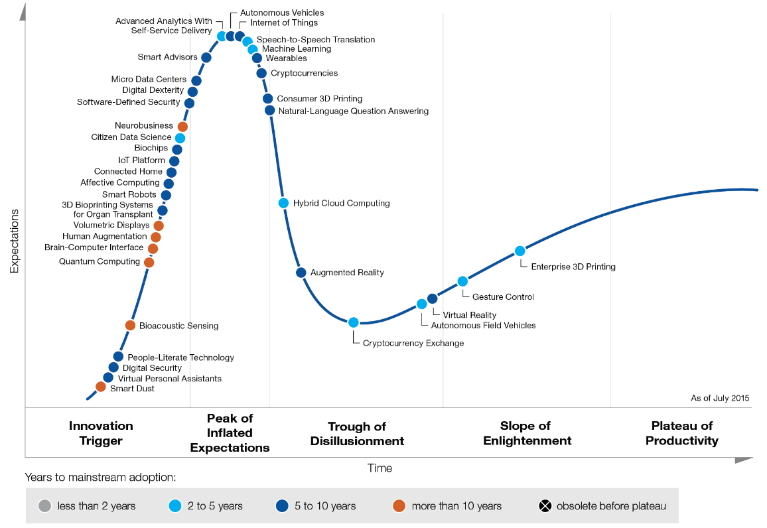
MACHINE LEARNING BACKGROUND
WHY ML ? --Emerging Technology Hype Cycle
Longhow Lam,2012
Notes:
技术成熟度曲线(The Hype Cycle),又称技术循环曲线,光环曲线,炒作周期,指的是企业用来评估新科技的可见度,

Slide 21
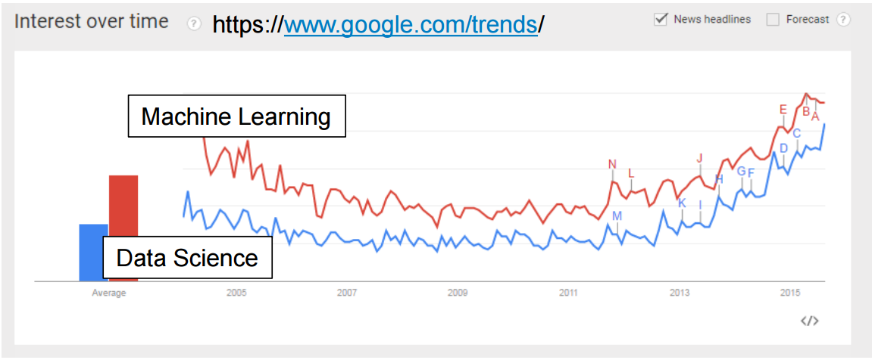
MACHINE LEARNING BACKGROUND
WHY NOW ?
Powerful computing resources have become available
Data is a commodity: more and different types of data have become available
Rise of the “data scientist”
Longhow Lam,2012

Slide 22
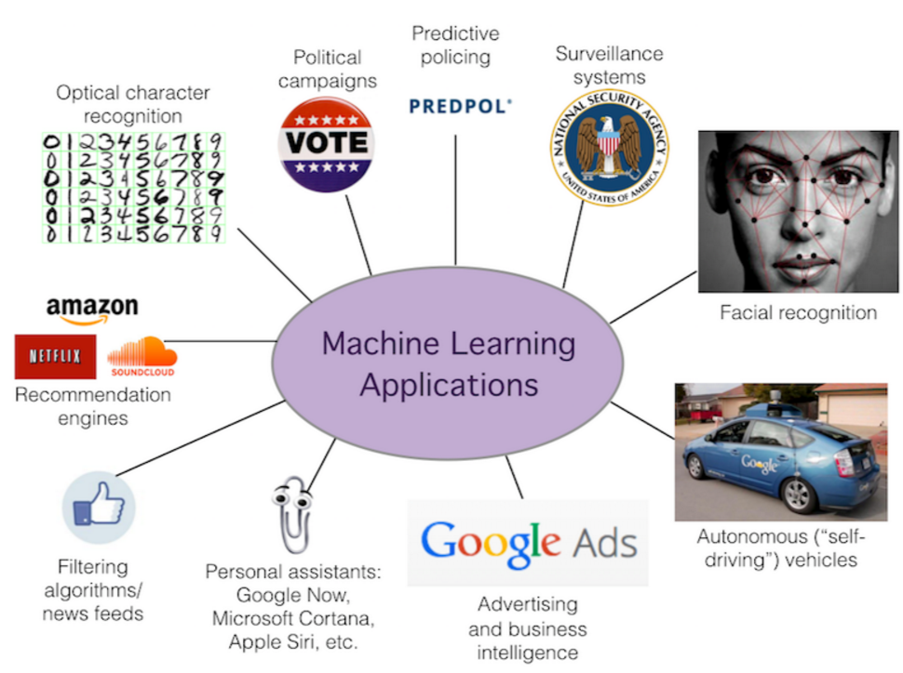
MACHINE LEARNING BACKGROUND
What ML can do?

Slide 23
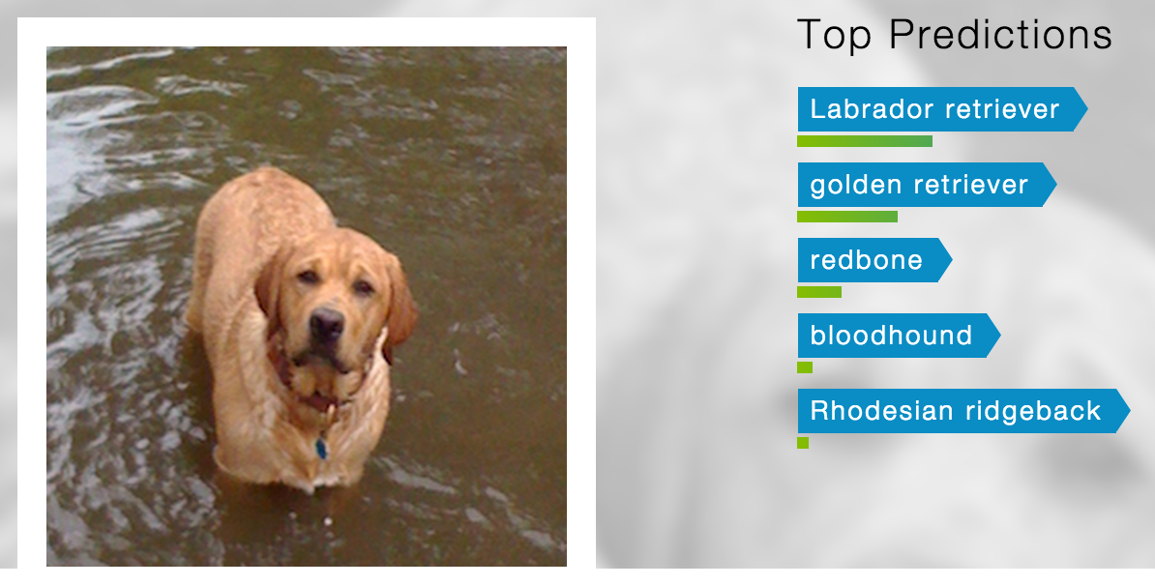
MACHINE LEARNING BACKGROUND
Classification
Predict amongst a discrete set of classes
Input
Output
Alice Zheng,2015

Slide 24
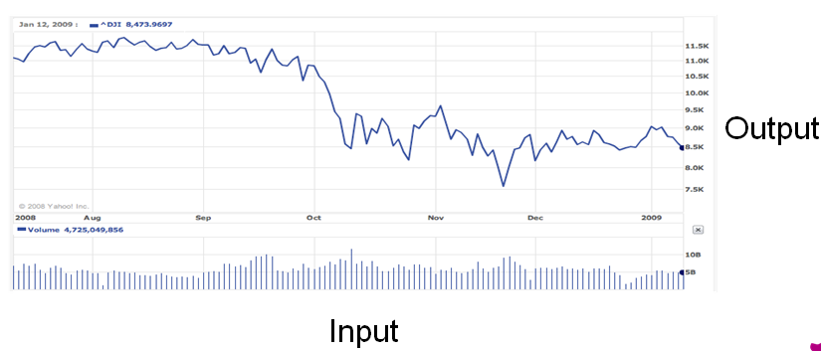
MACHINE LEARNING BACKGROUND
Regression Predict real/numeric values
Stock market
Alice Zheng,2015

Slide 25
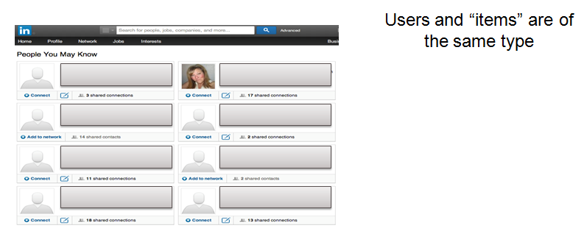
MACHINE LEARNING BACKGROUND
Playlist recommendations
Friend recommendations
Alice Zheng,2015

Slide 26
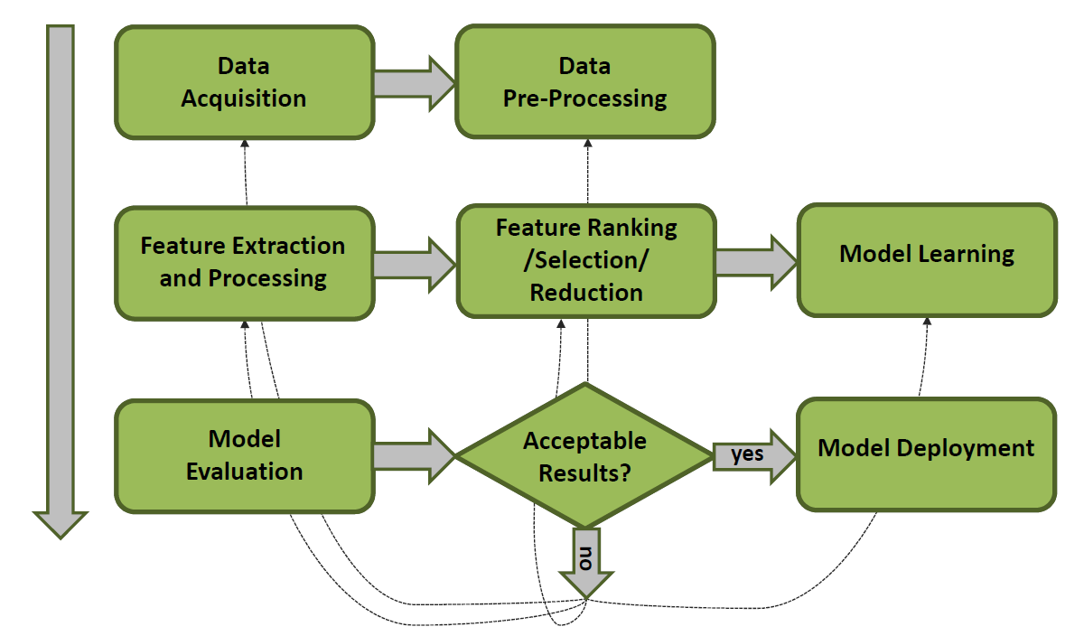
Terminology / Basic Concepts
HOW ML ? --The learning process
Rui Pedro Paiva,2013

Slide 27
Terminology / Basic Concepts
Terminology / Basic Concepts
Samples
A sample is an item to process. It can be a document, a picture, a sound, a video, a row in database or CSV file, data types, sample size, online/offline.
Features
The number of features or distinct traits that can be used to describe each item in a quantitative manner.
Feature types
Numeric, continuous
Nominal, i.e., discrete categories
Feature extraction
Preparation of feature vector
Transforms the data in the high-dimensional space to a space of fewer dimensions.
Labels (or outputs)
Instances’ annotated values, e.g., classes or numeric values
Training set
Set of examples used to learn the model, i.e., to train the classifier, regressor, etc.
Test set
Independent, unseen, examples used to evaluate the learnt model

Slide 28
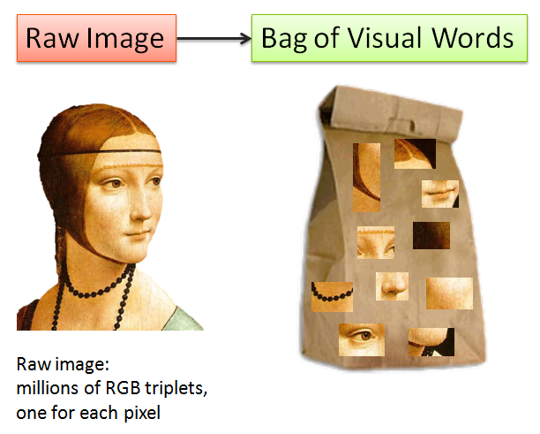
Terminology / Basic Concepts
Feature extanction
Alice Zheng,2015

Slide 29
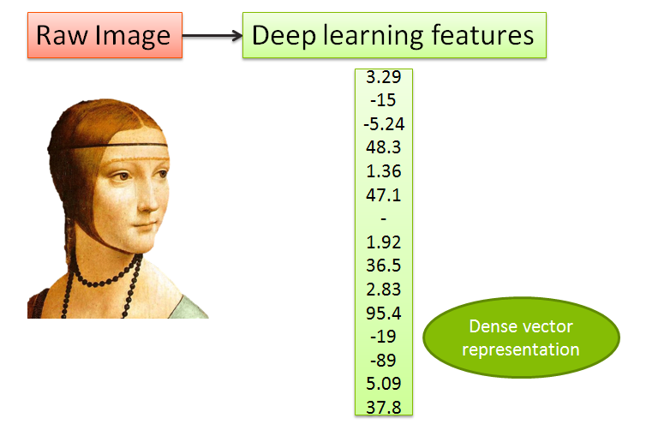
Terminology / Basic Concepts
Feature extanction
Alice Zheng,2015

Slide 30
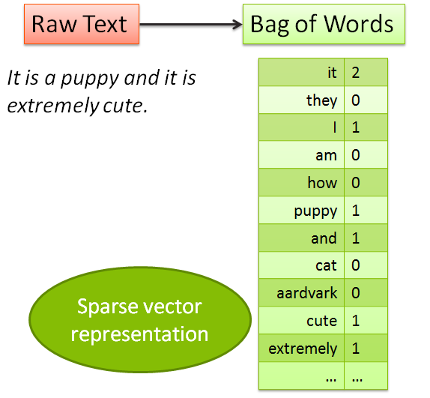
Terminology / Basic Concepts
Feature extanction
Alice Zheng,2015

Slide 31
Terminology / Basic Concepts
Algorithms Grouped by Learning Style
Supervised Learning
Generates a function that maps inputs to desired outputs.
Probably, the most common paradigm
More accurate
Labeled data required
Requires human in the loop

Slide 32
Terminology / Basic Concepts
Algorithms Grouped by Learning Style
Supervised Learning
Generates a function that maps inputs to desired outputs.
Probably, the most common paradigm
More accurate
Labeled data required
Requires human in the loop
Unsupervised Learning
Less accurate
No need for a teacher, try to learn relationships automatically
Automatically recognize patterns and organize the content

Slide 33
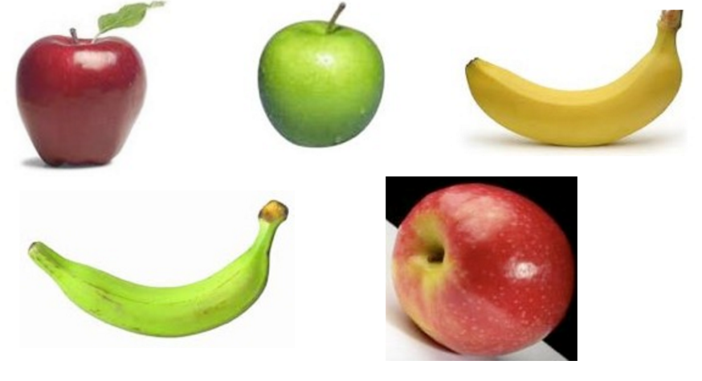
Terminology / Basic Concepts
Algorithms Grouped by Learning Style
Supervised Learning
Generates a function that maps inputs to desired outputs.
Probably, the most common paradigm
More accurate
Labeled data required
Requires human in the loop
Unsupervised Learning
Less accurate
No need for a teacher, try to learn relationships automatically
Automatically recognize patterns and organize the content

Slide 34
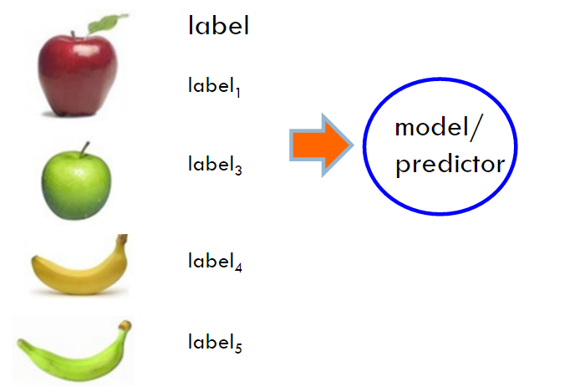
Terminology / Basic Concepts
Algorithms Grouped by Learning Style
Supervised Learning
Generates a function that maps inputs to desired outputs.
Probably, the most common paradigm
More accurate
Labeled data required
Requires human in the loop
Unsupervised Learning
Less accurate
No need for a teacher, try to learn relationships automatically
Automatically recognize patterns and organize the content

Slide 35
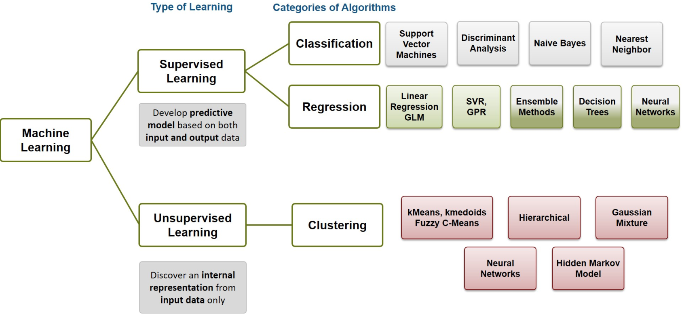
Terminology / Basic Concepts
Algorithms Grouped by Learning Style

Slide 36
First ML Toy Example
Spam Filtering
Learning=Improving with experience at some task
Improve over task T,
With respect to performance measure , P
Based on experience, E

Slide 37
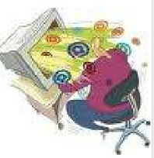
First ML Toy Example
Spam Filtering
Learning=Improving with experience at some task
Improve over task T,
With respect to performance measure , P
Based on experience, E
Lior Rokach,2004

Slide 38
First ML Toy Example
Spam Filtering
Learning=Improving with experience at some task
Improve over task T,
With respect to performance measure , P
Based on experience, E
T: Identify Spam Emails
P:
--% of spam emails that were filtered;
--% of harm/(non-spam)emails that were incorrectly filtered-out
E: a database of emails that were labeled by users
Lior Rokach,2004

Slide 39
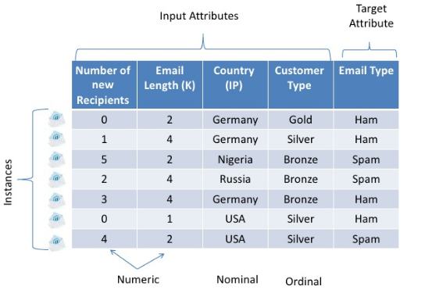
First ML Toy Example
Data Set
Lior Rokach,2004

Slide 40
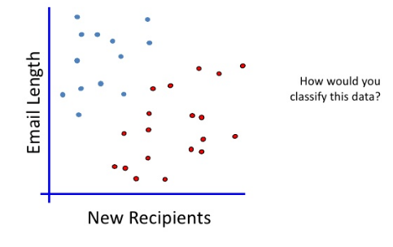
First ML Toy Example
Feature extraction
Lior Rokach,2004

Slide 41
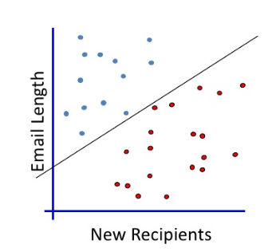
First ML Toy Example
Linearly separable case
Lior Rokach,2004
Notes:
The maximum margin linear classifier is the linear classifier with the maximum margin
This is the simplest kind of svm

Slide 42
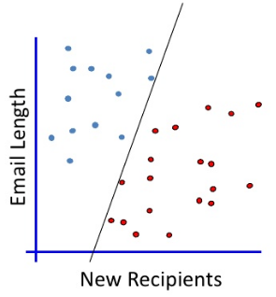
First ML Toy Example
Linearly separable case
Lior Rokach,2004
Notes:
The maximum margin linear classifier is the linear classifier with the maximum margin
This is the simplest kind of svm

Slide 43
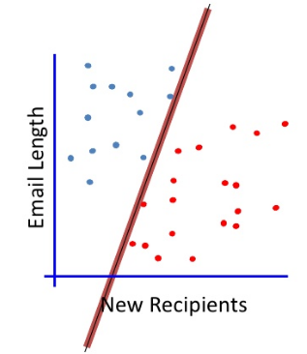
First ML Toy Example
Linearly separable case
Lior Rokach,2004
Notes:
The maximum margin linear classifier is the linear classifier with the maximum margin
This is the simplest kind of svm

Slide 44
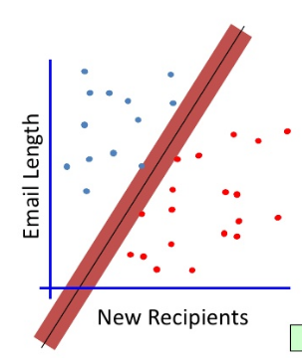
First ML Toy Example
Linearly separable case
Lior Rokach,2004
Notes:
The maximum margin linear classifier is the linear classifier with the maximum margin
This is the simplest kind of svm

Slide 45
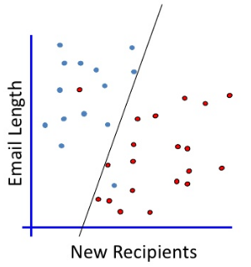
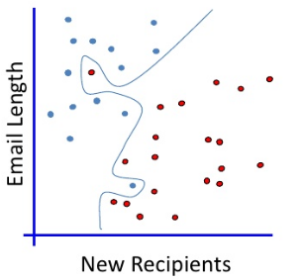
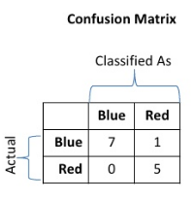
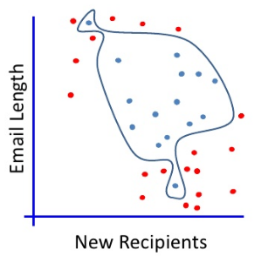
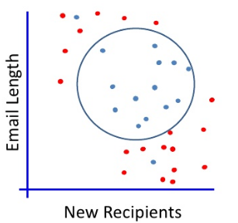
First ML Toy Example
Generalization/ The Non-linearly separable case
Lior Rokach,2004
Notes:
Ideally, the best decision boundary should be the one which provides an optimal performance such as in the following figure
However, our satisfaction is premature because the central aim of designing a classifier is to correctly classify novel input→ issue of generalization
Evaluating what’s been learned: randomly select , train the model on training set, run the model on the remaining instances

Slide 46
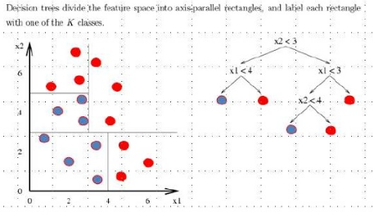
First ML Toy Example
Decision tree
A flow-chart-like tree structure
Internal node denotes a test on an attribute
Branch represents an outcome of the test
Leaf notes represent class labels or class distribution
Lior Rokach,2004

Slide 47
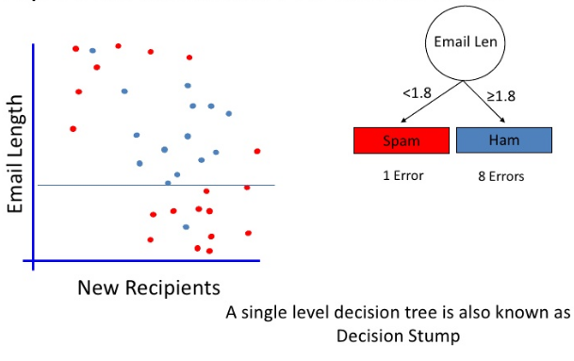
First ML Toy Example
Top Down Induction of Decision Trees
Lior Rokach,2004

Slide 48
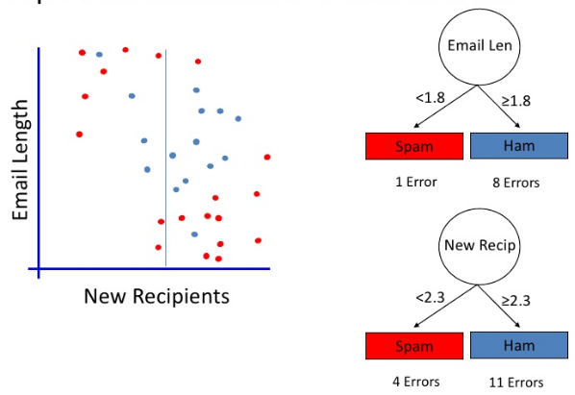
First ML Toy Example
Top Down Induction of Decision Trees
Lior Rokach,2004

Slide 49
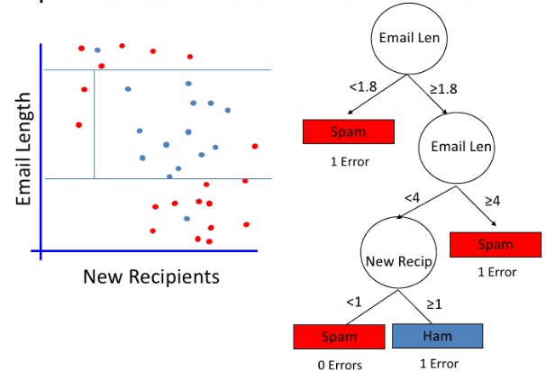
First ML Toy Example
Top Down Induction of Decision Trees
Lior Rokach,2004

Slide 50
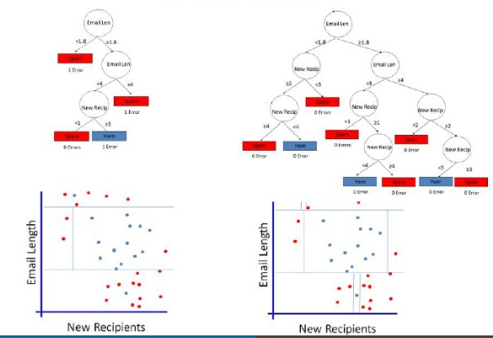
First ML Toy Example
Which One ?
Lior Rokach,2004

Slide 51
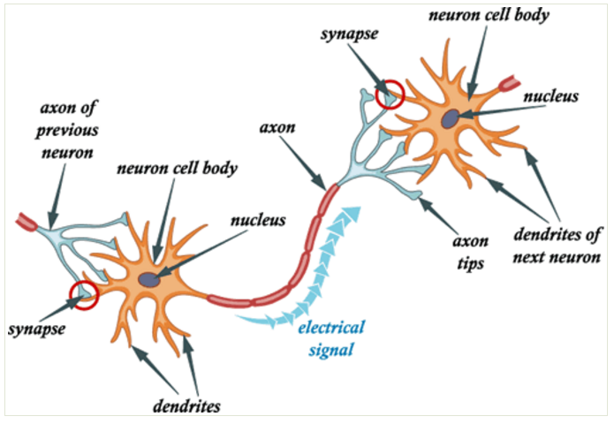
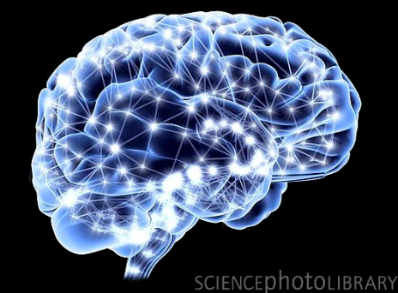
First ML Toy Example
ANN
10^12 neurals
10^14 synapse
Receives signal on synapse
When trigger send signal on axon
http://www.cnblogs.com/subconscious/p/5058741.html

Slide 52
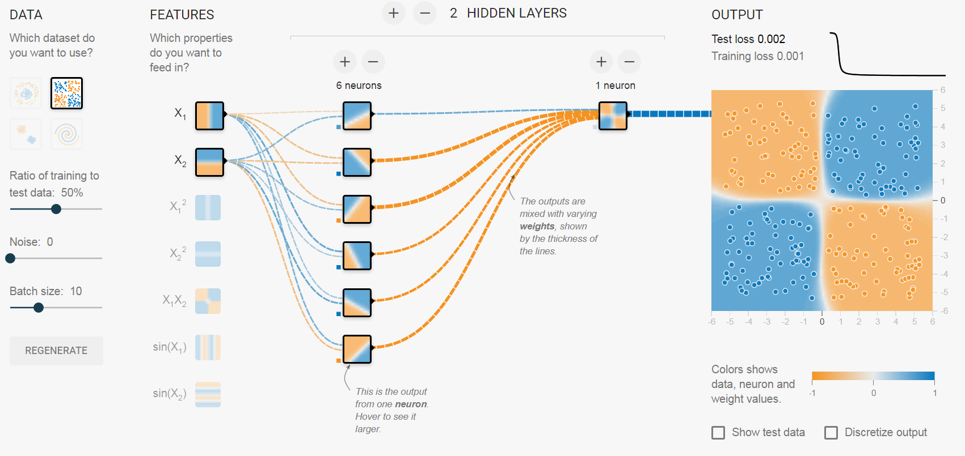
First ML Toy Example
ANN

Slide 53
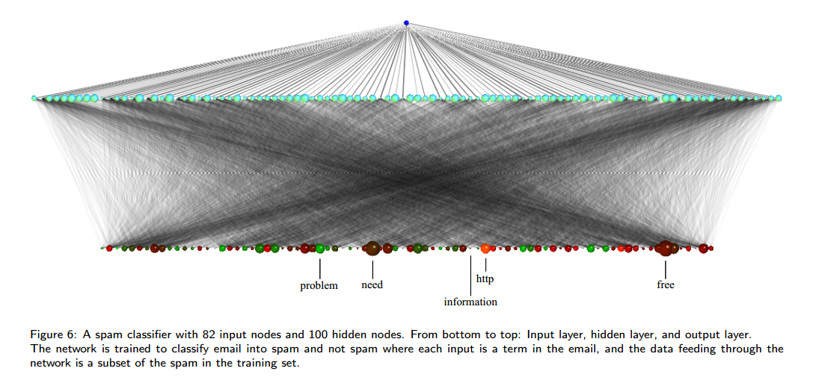
First ML Toy Example
First ML Toy Example
Notes:
In Figure 6,
the nodes for “free” and “need” are large, which indicate that they are two important words to distinguish spam and not spam in the data set.
“Http” occurs in almost all the spam, which is indicated by the red color of the node since red represents high mean and low standard deviation

Slide 54
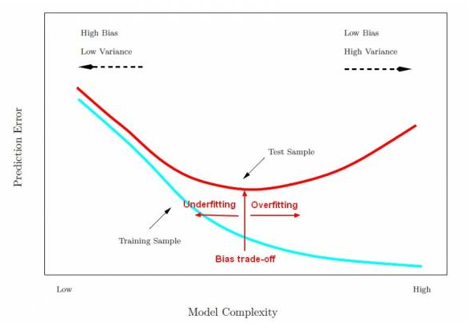
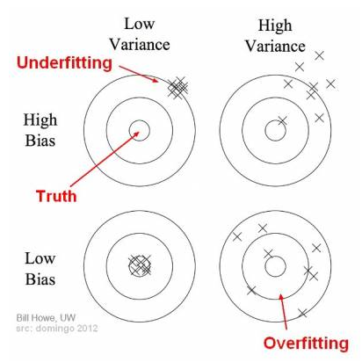
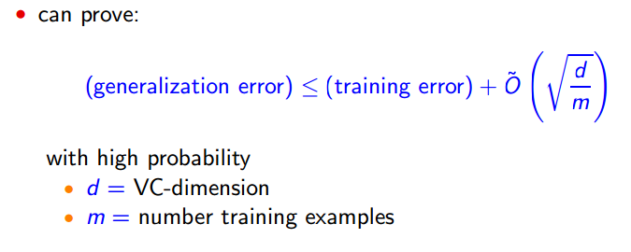
First ML Toy Example
Model Evaluation
http://gerardnico.com/wiki/data_mining/overfitting http://www.cs.princeton.edu/~schapire/talks/picasso-minicourse.pdf

Slide 55
First ML Toy Example
Model Evaluation
Basic Definitions
Training set
Set of examples used to learn the model, i.e., to train the classifier, regressor, etc.
Test set
Independent, unseen, examples used to evaluate the learnt model
Performance Metrics
Classification
Confusion matrix, Class True Positive (TP) rate, Precision/Recall, F-measure
Regression
Root mean squared error, Mean Absolute Error, Pearson’s Correlation Coefficient(R), Coefficient of Determination(R2)
Clustering
If labels are available, compare created clusters with class labels; otherwise, expert evaluation
Association
Expert evaluation

Slide 56
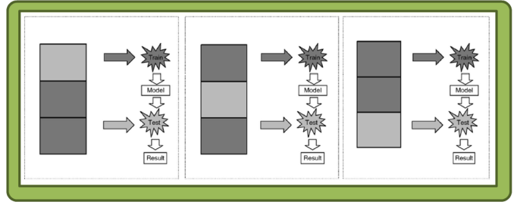
First ML Toy Example
Evaluation Strategies
Evaluation Strategies
Training set (a.k.a Resubstitution Validation)
Evaluate model performance using some metric (see section Evaluation Metrics) resorting only to the training set
Train-Validate-Test (TVT)
Training set: learn the model
Validation set: used to evaluate parameter optimization, feature selection, compare models, etc.
Test set: used to evaluate the final accuracy of the optimized model
K-fold Cross-Validation (Typically, k = 10)
1. Randomly separate the entire set into a number of stratified k equal-size folds (partitions)
2. Train using k-1folds, test using the remaining fold
3. Repeat training and testing (step 2) k times, alternating each fold in the test set
4. Repeat steps 1 to 3 a number of times (reshuffle and restratify data)
5. Average the results
Notes:
– 3 independent datasets
– Training set: learn the model
– Validation set: used to evaluate parameter optimization,
feature selection, compare models, etc.
– Test set: used to evaluate the final accuracy of the optimized
model

Slide 57
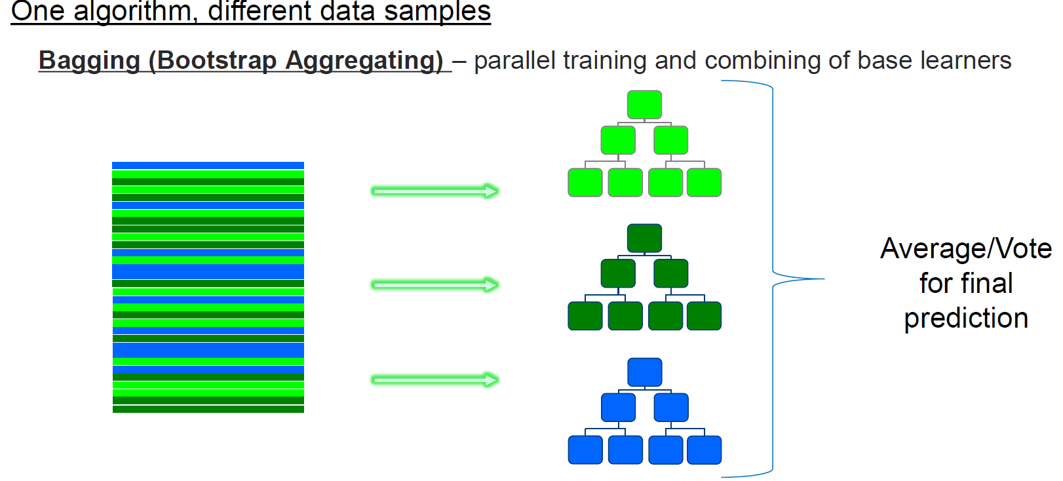
First ML Toy Example
Improve Strategies
Rui Pedro Paiva,2013

Slide 58
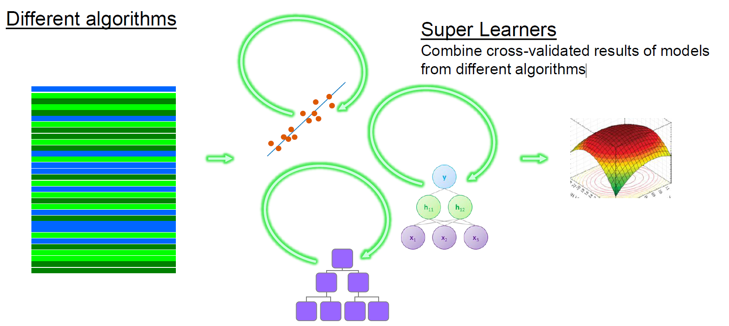
First ML Toy Example
Improve Strategies
Rui Pedro Paiva,2013

Slide 59
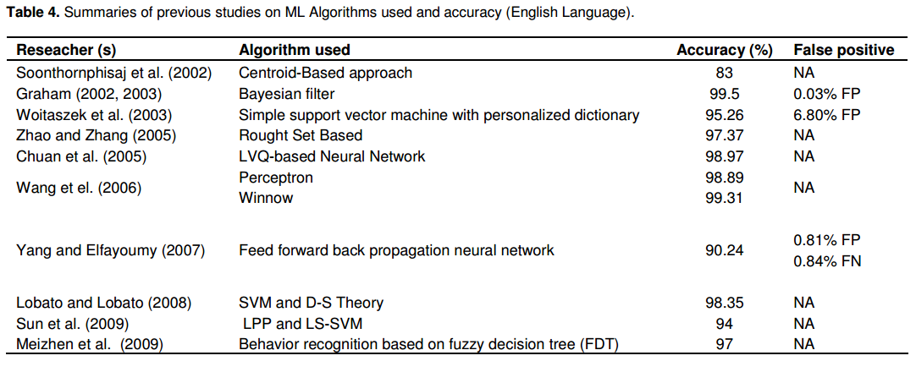
First ML Toy Example
Part of adoption ML Algorithms for Spam Filtering
Thamarai Subramaniam,2010

Slide 60
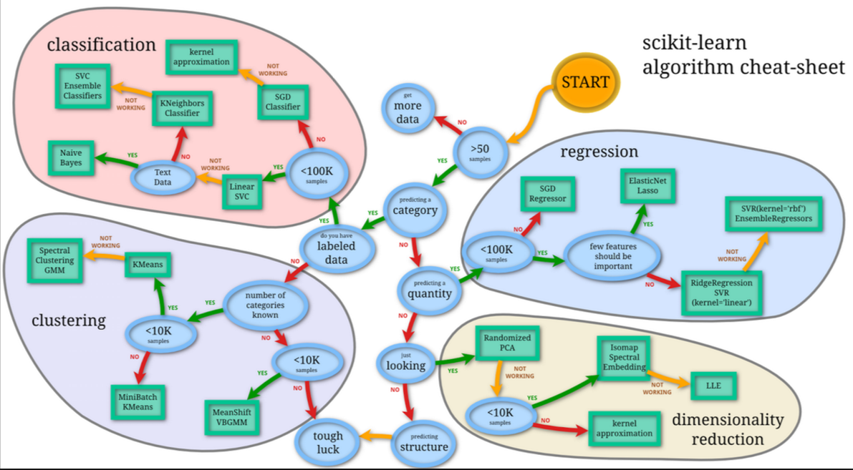
HOW TO BE MLer
ML Cheat sheet
http://scikit-learn.org/stable/tutorial/

Slide 61
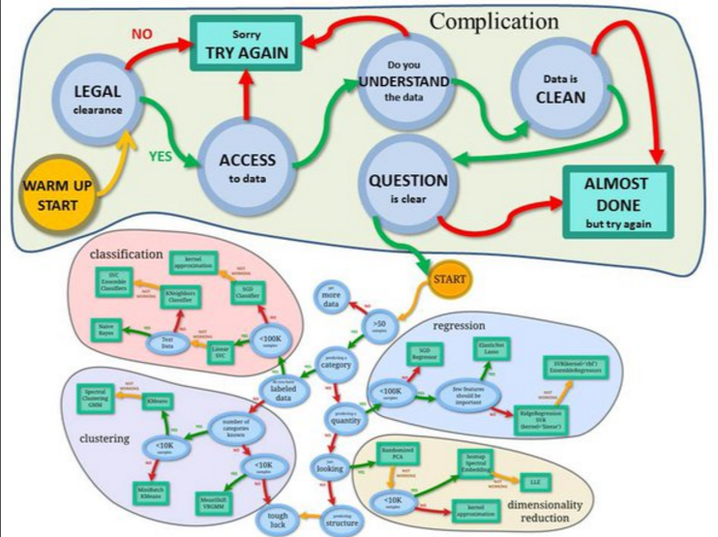
HOW TO BE MLer
ML Cheat sheet
http://scikit-learn.org/stable/tutorial/

Slide 62
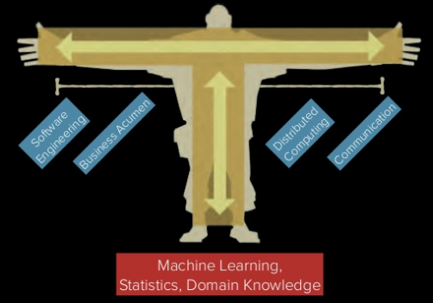
How can I become a Data Scientist
T-shaped Skillset
Alexander Crépin,2016

Slide 63

http://nirvacana.com/thoughts/becoming-a-data-scientist/

Slide 64

How can I become a Data Scientist
MACHINE LEARNING LANDSCAPE
https://d3ansictanv2wj.cloudfront.net/mi-landscape-2.0-r9_update-f2048bd678f522066e294ba8233b6615.jpg

Slide 65

How can I become a Data Scientist
Course Materials
Stanford's machine learning course presented by Professor Andrew Ng.
01 : Introduction, Regression Analysis and Gradient Descent
02: Linear Regression with Multiple Variables
03: Logistic Regression
04: Regularization
05: Neural Networks - Representation
06: Neural Networks - Learning
07: Support Vector Machines
08: Clustering
09: Advice for applying machine learning techniques ( Hadoop, Spark, Tensorflow )
10: Machine Learning System Design
https://www.coursera.org/learn/machine-learning/home/info#

Slide 66
INTRODUCTION
Success Review
Traditional CS vs machine learning
Three basic processes in machine learning
Difference between supervised learning and unsupervised learning
How evaluate the trained model

Slide 67


Slide 68

What is deep learning?
A collection of statistical machine learning techniques
Used to learn feature hierarchies
Often based on artificial neural networks
Larry Brown Ph.D. May 2015

Slide 69

Appendix 1
What is deep learning?
Larry Brown Ph.D. May 2015

Slide 70

Appendix 1
What is deep learning?
Larry Brown Ph.D. May 2015

Slide 71

Appendix 1
What is deep learning?
Larry Brown Ph.D. May 2015

